Slide 1

Presentation on
Farmlog : An Insightful App For Modern Farming Practices.
Presented By
Shekhar Patil (20210801123)
Rohit Patil (20210801128)
Manish Parihar (20210801124)
Guided By
Dr. Sarika Jadhav
Professor
School of Computer Science, Engineering and Application
D Y Patil International University, Akurdi, Pune

Slide 2
AGENDA
01
04
02
05
03
06
Introduction
Limitations
Technology used
Future Scopes
System Design
Conclusion

Slide 3
INTRODUCTION
An event management system showcases its broad applicability across various domains and industries, serving as a versatile tool for efficient event planning, organization, and participation. From individuals organizing personal gatherings to businesses managing large conferences and public events, this application proves its utility. It is particularly valuable in sectors requiring precise coordination and attendee management, such as corporate events, entertainment, and education. The system enhances workflow in industries like healthcare for medical conferences, the legal sector for seminars, and government agencies for public events. Freelancers, entrepreneurs, and small businesses benefit from its streamlined booking and promotion capabilities. Whether in tourism, hospitality, real estate, or non-profit sectors, the adaptability of this application supports effective event handling, compliance with regulations, and improved operational efficiency, making it an indispensable tool in today’s interconnected world.

Slide 4




TECHNOLOGY USED
PHP
PHP stands for PHP: Hypertext Preprocessor
PHP is a server-side scripting language, like ASP
PHP scripts are executed on the server
MYSQL
MYSQL is a database server
MYSQL is ideal for both small and large applications
MYSQL supports standard SQL
CSS
Cascading Style Sheets (CSS)
Simple mechanism
HTML
We have an HTML file that defines the structure of the webpage.

Slide 5
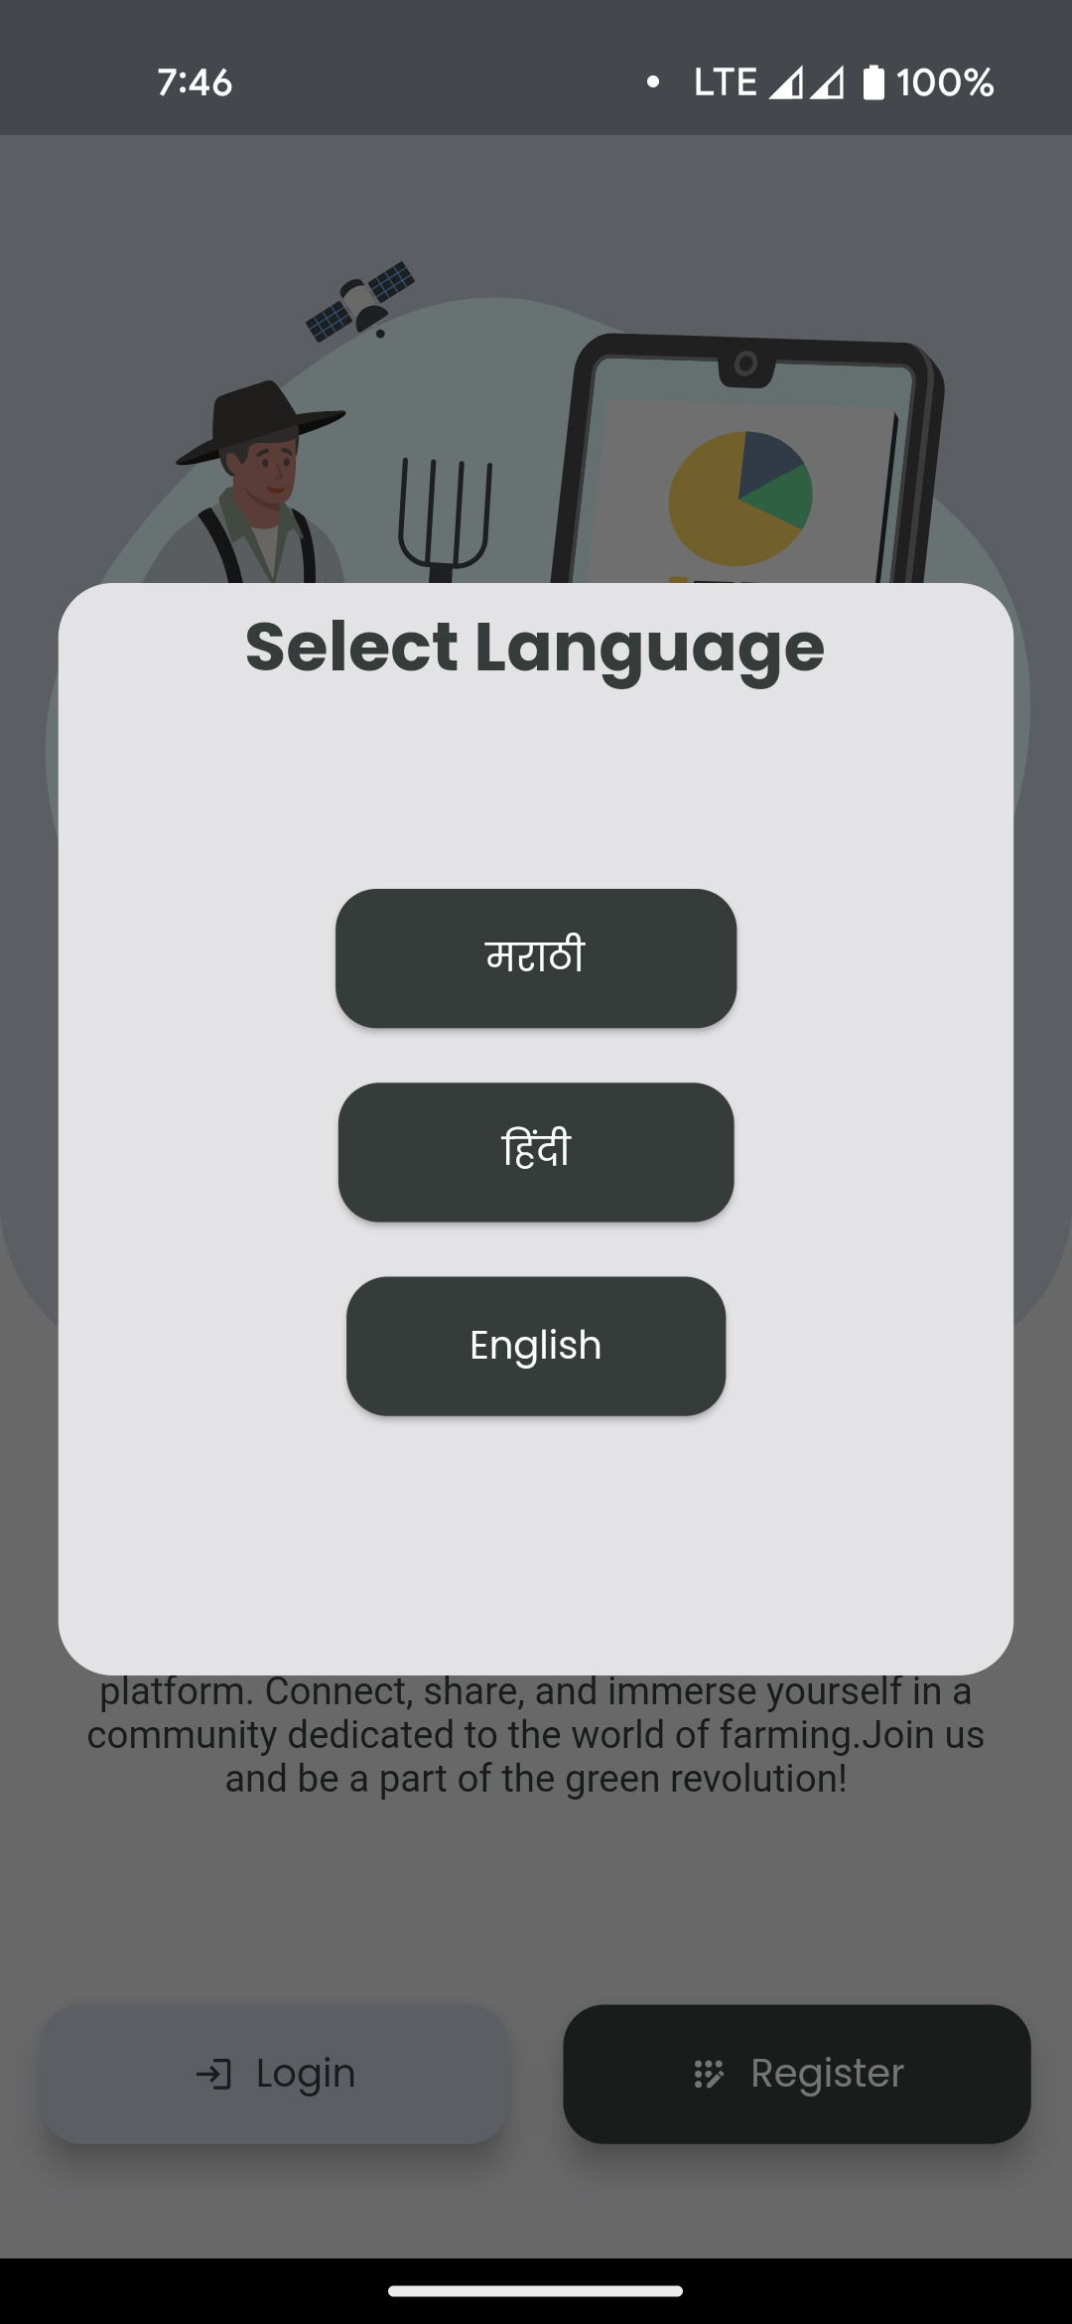
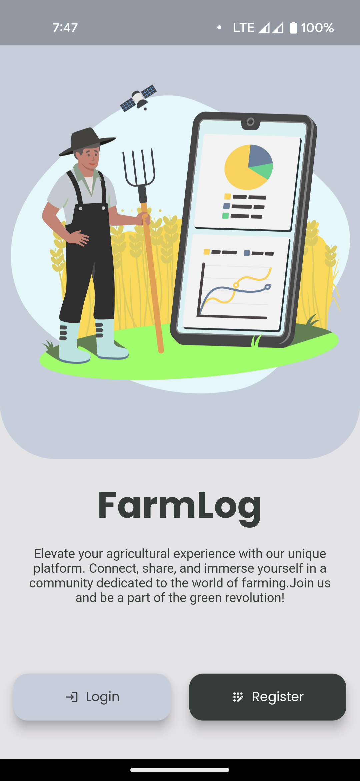
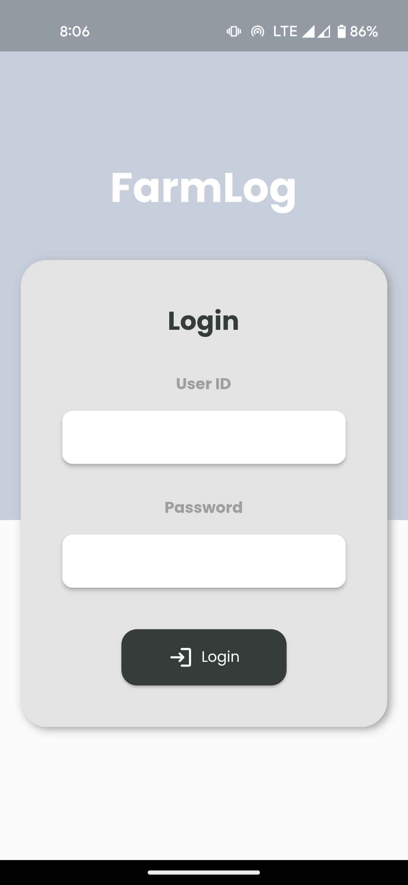
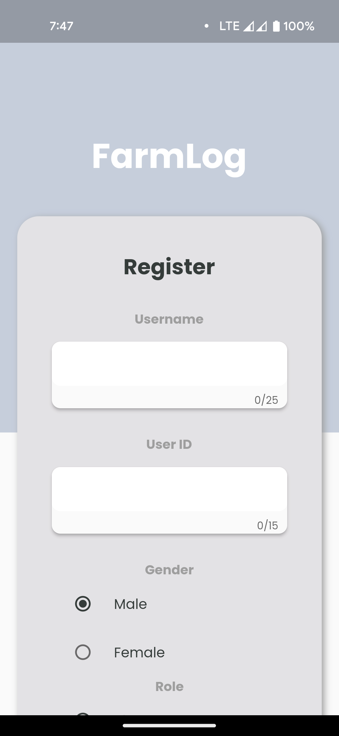
SYSTEM DESIGN
Input Output Screen

Slide 6
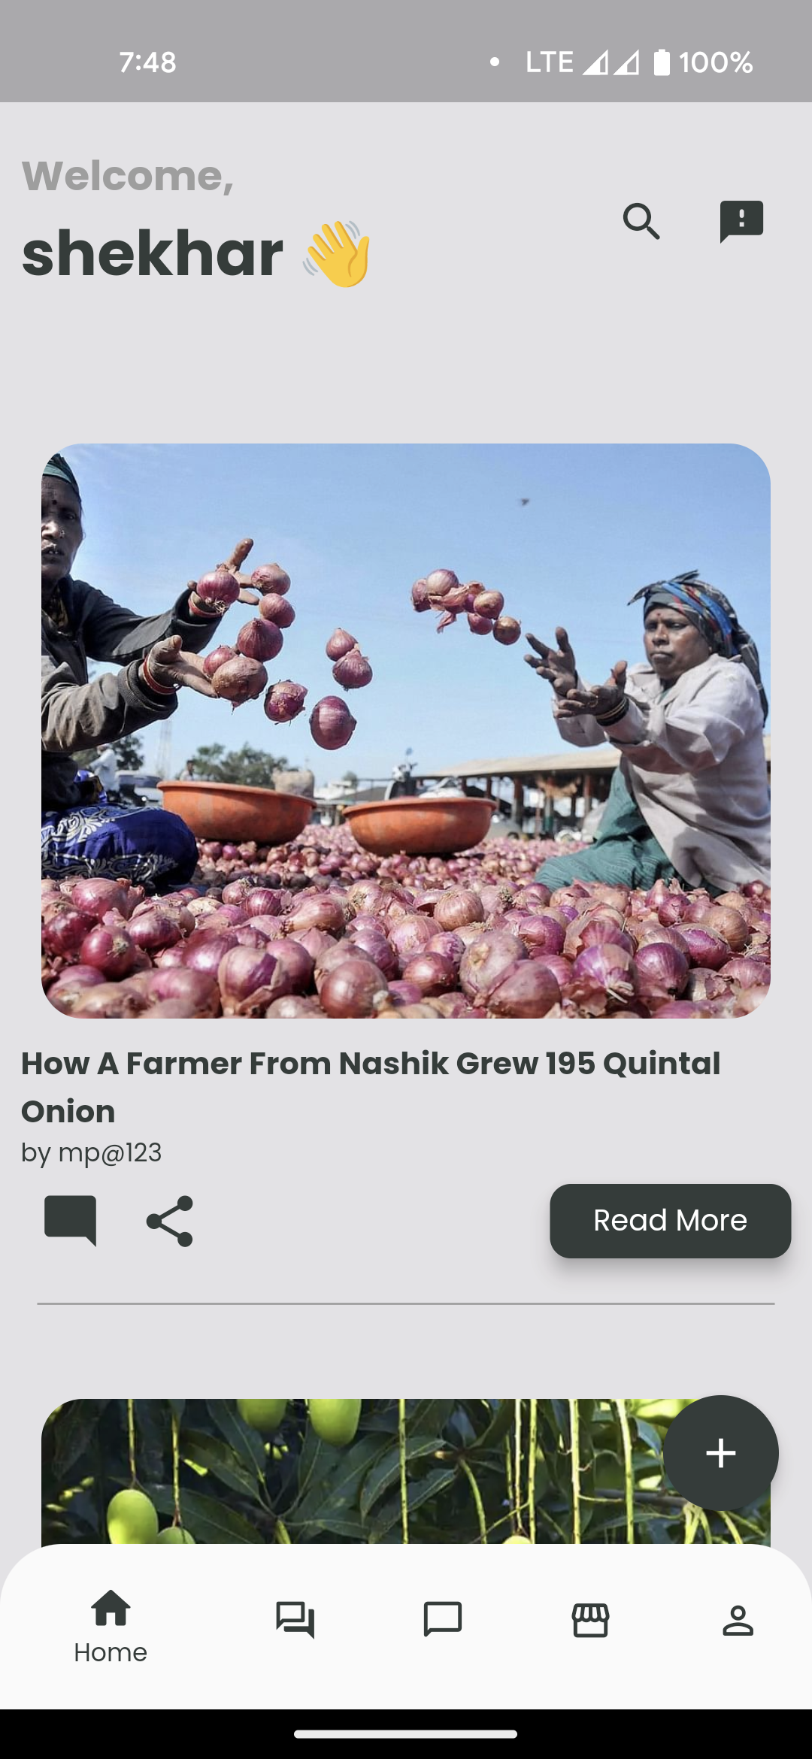
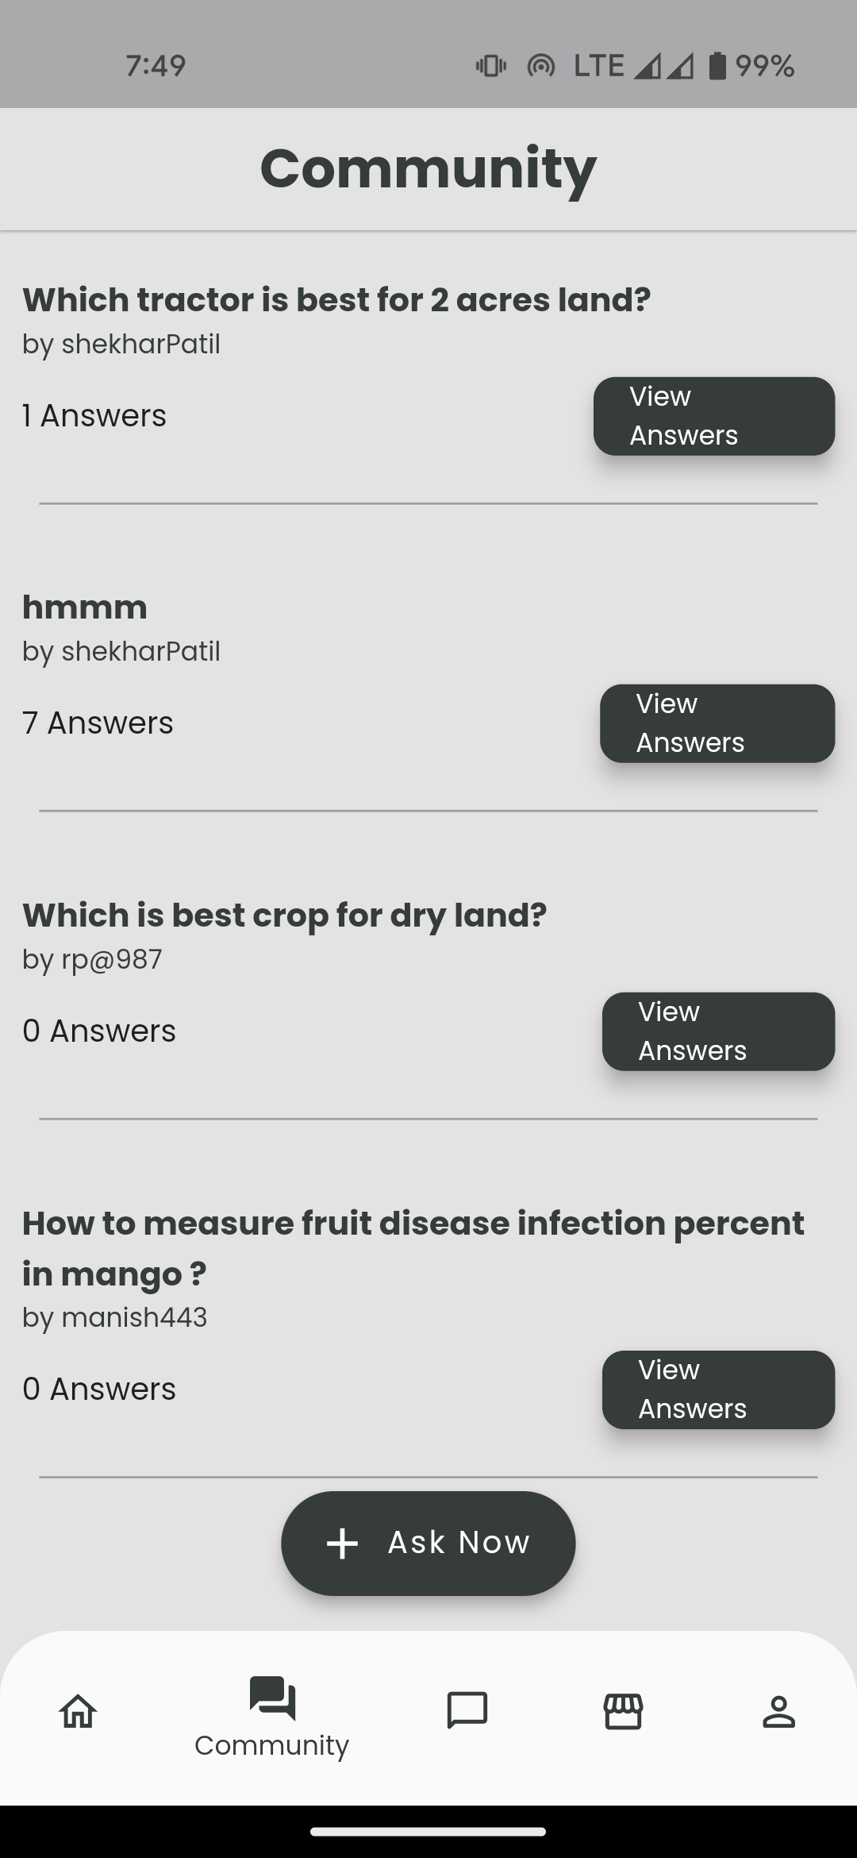
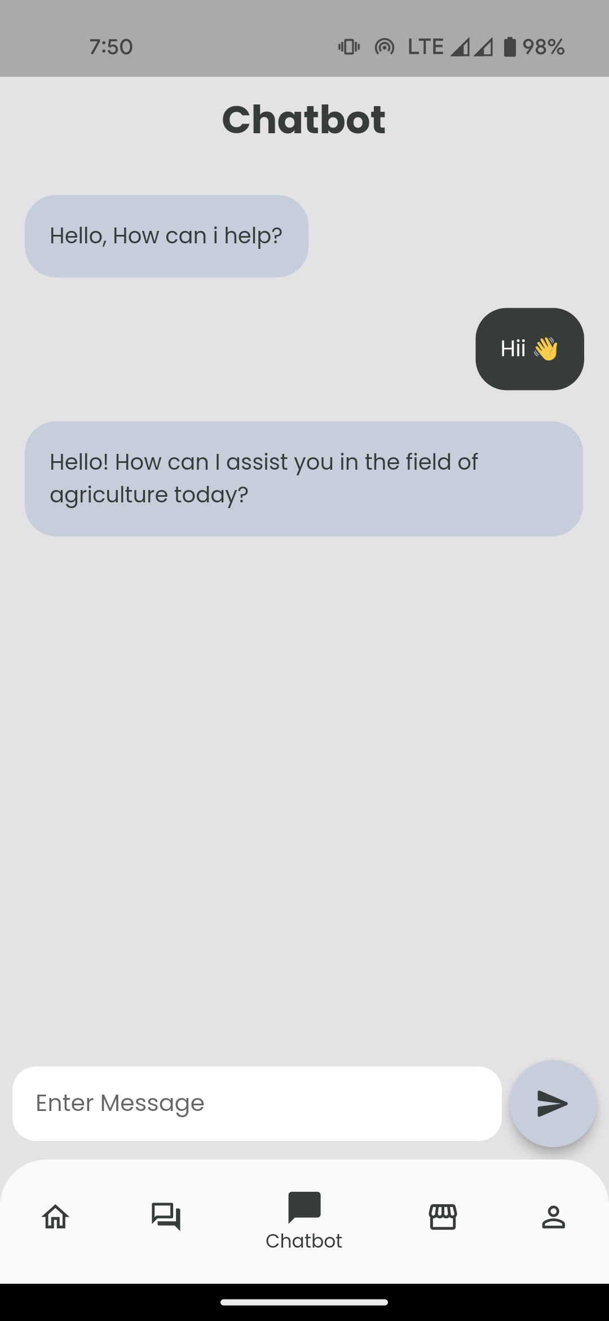
SYSTEM DESIGN
Input Output Screen

Slide 7
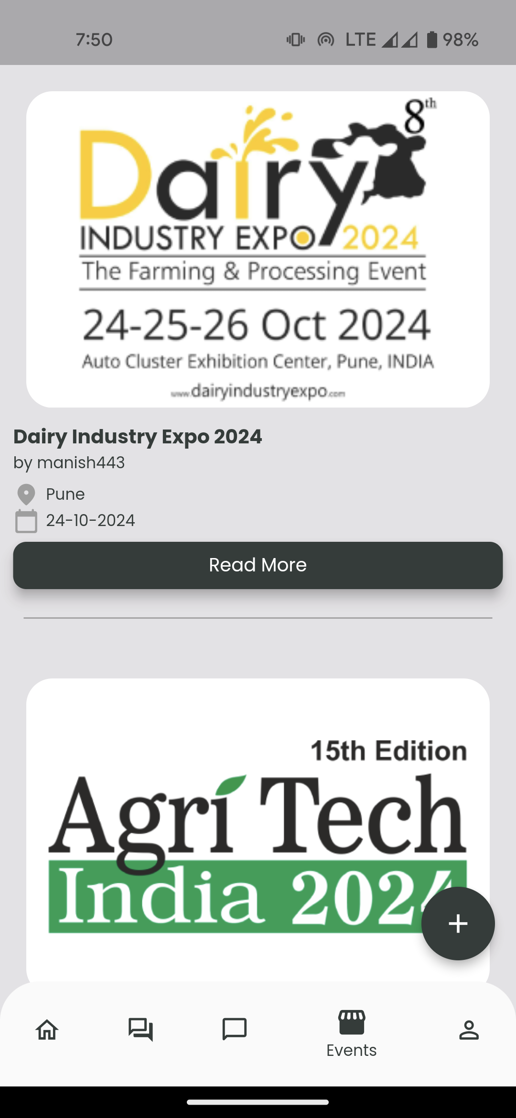
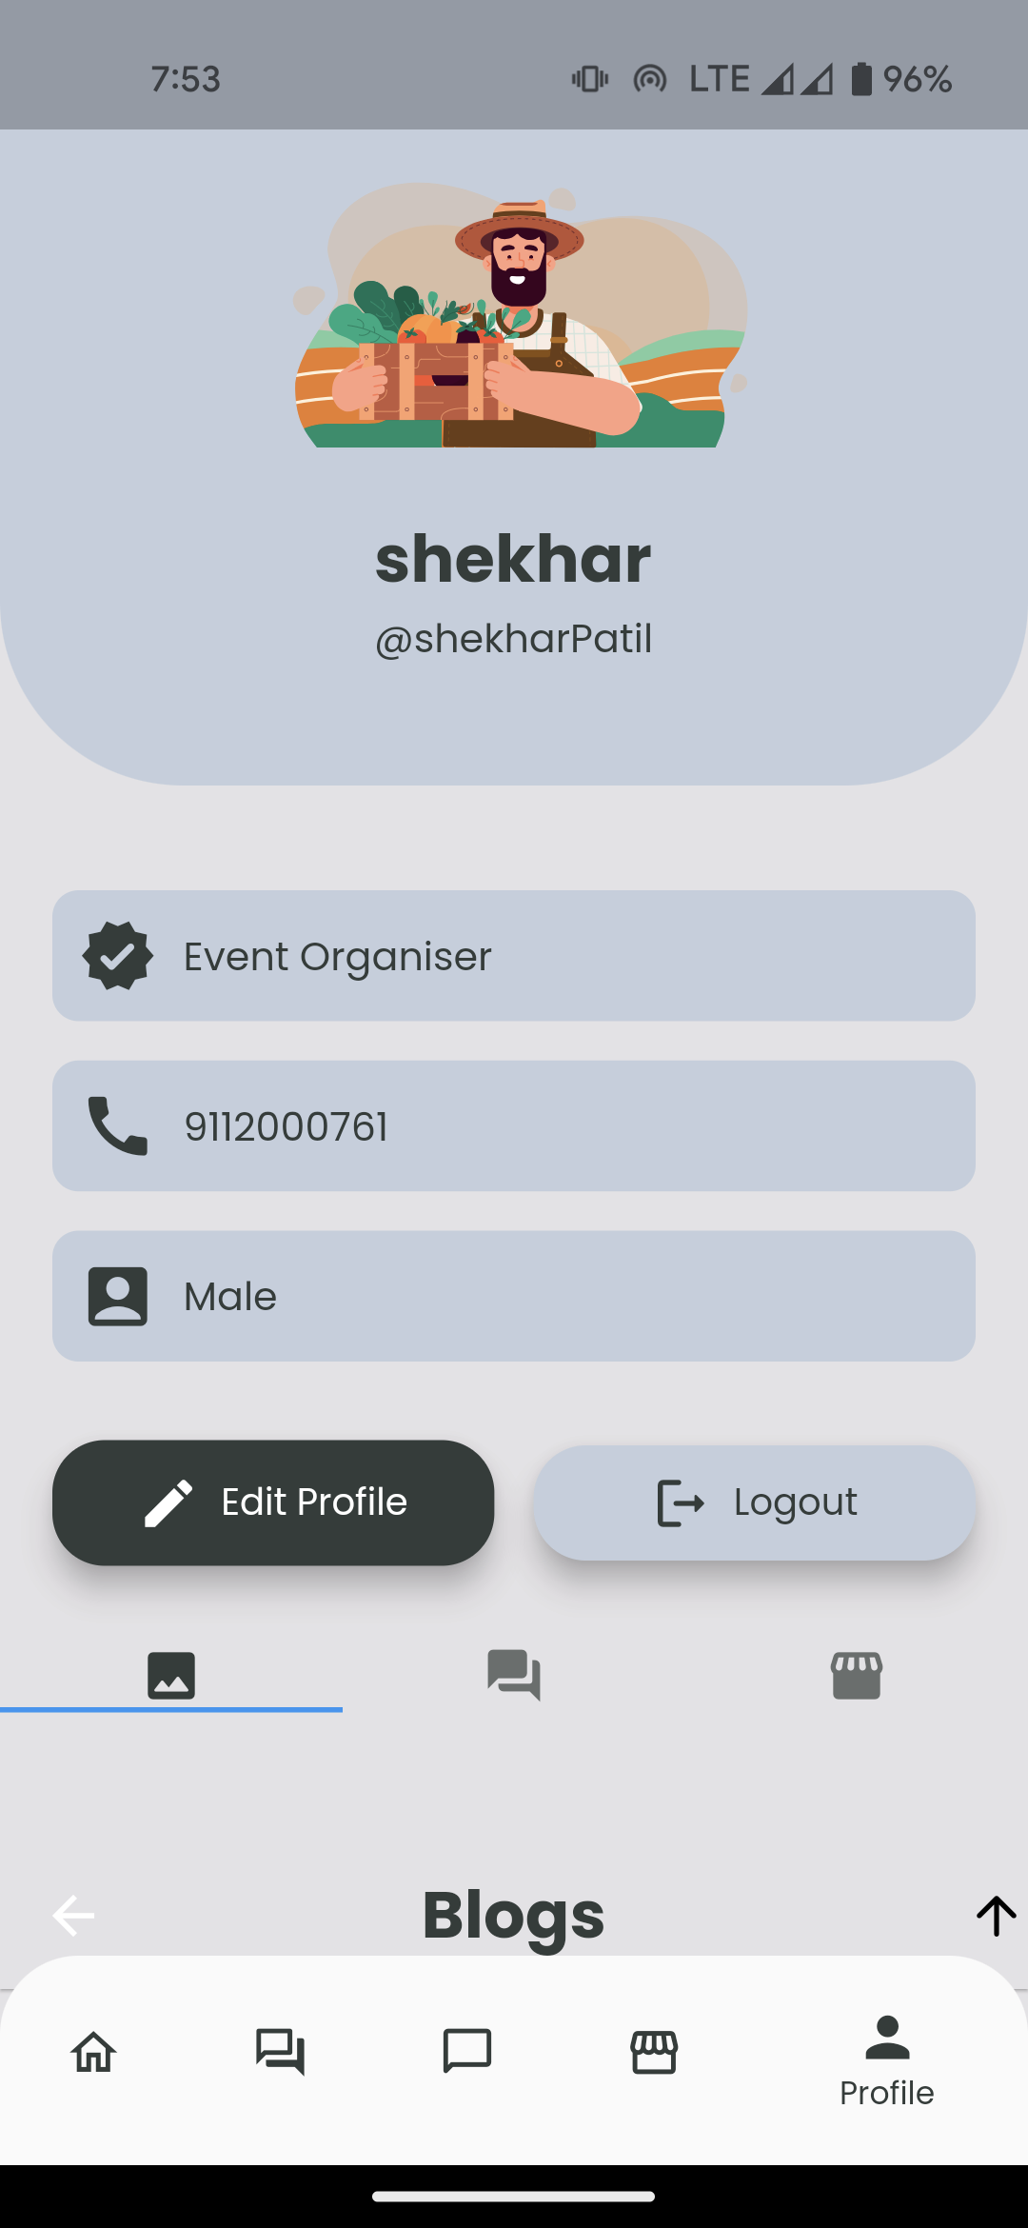
SYSTEM DESIGN
Input Output Screen

Slide 8
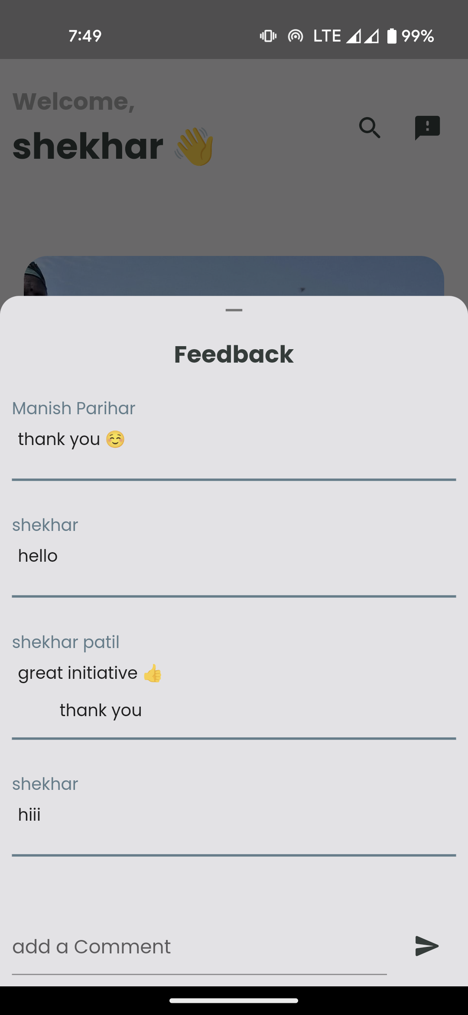
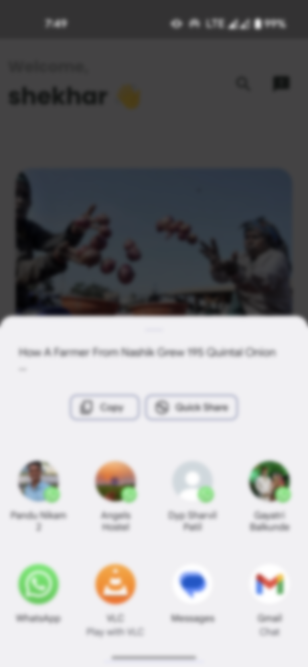
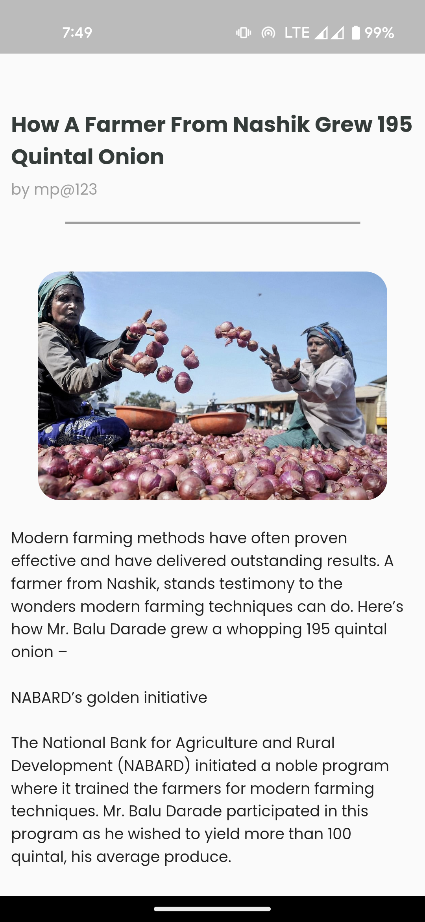
SYSTEM DESIGN
Input Output Screen

Slide 9
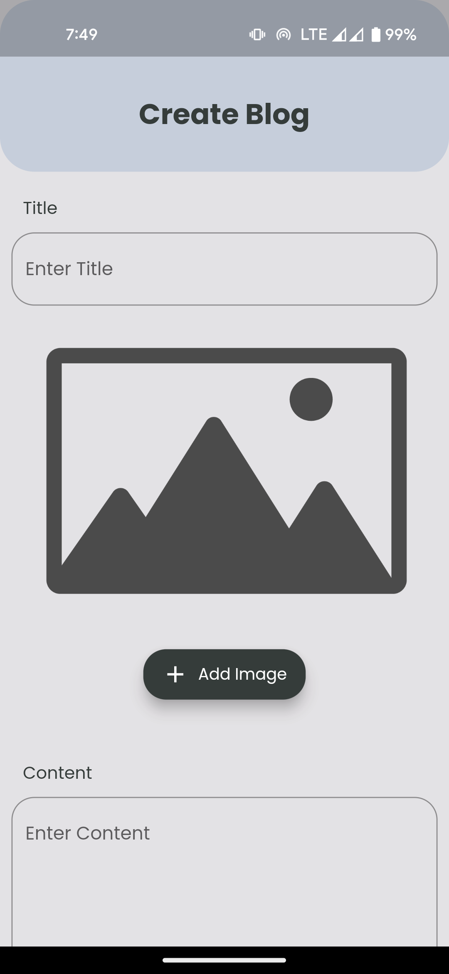
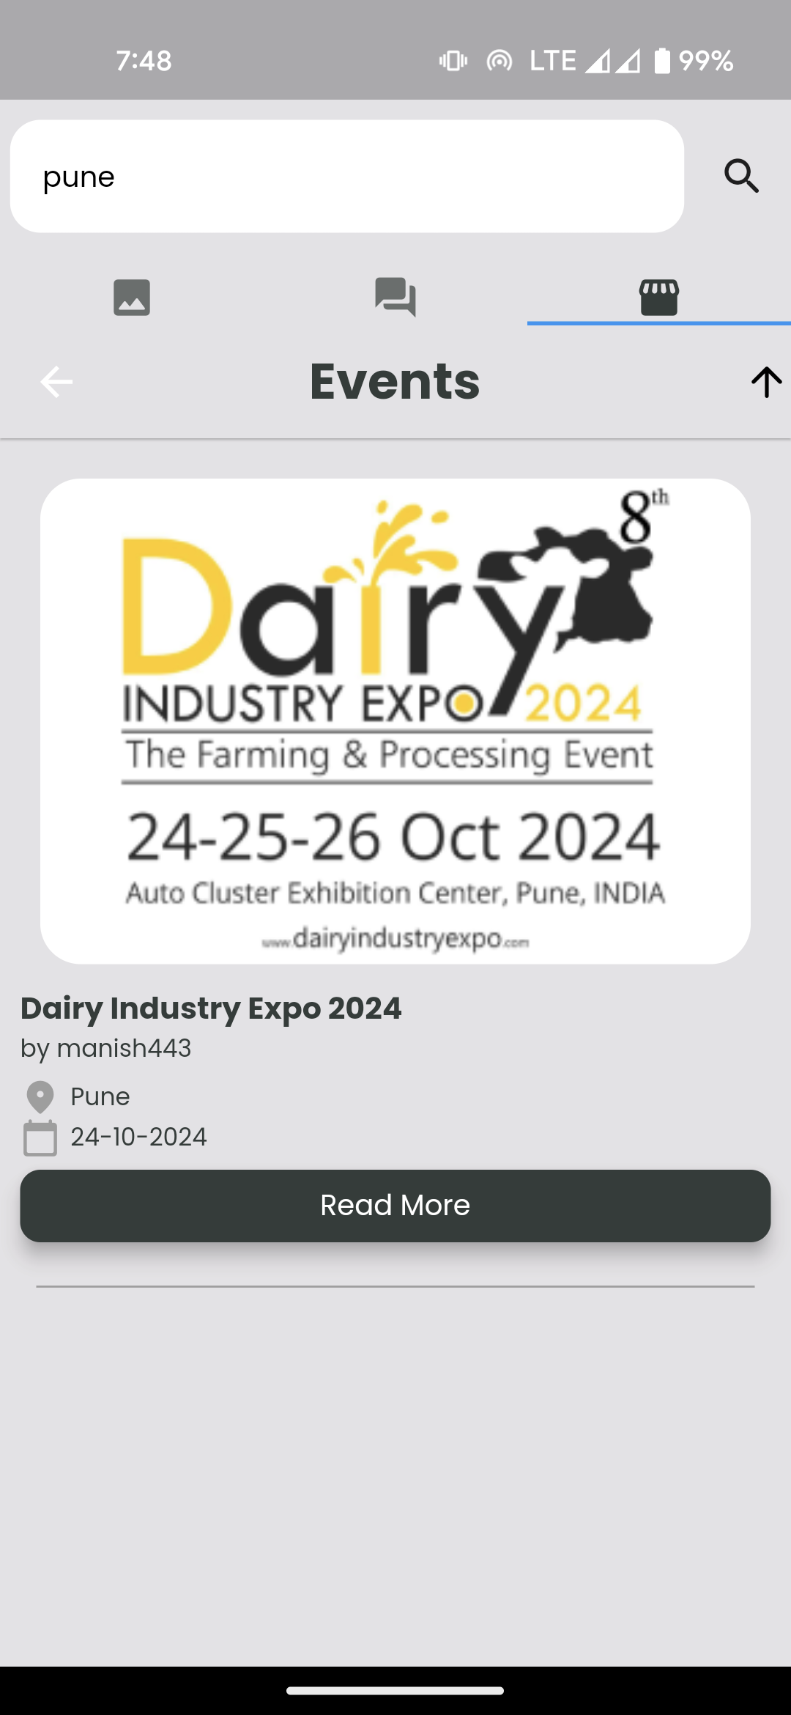
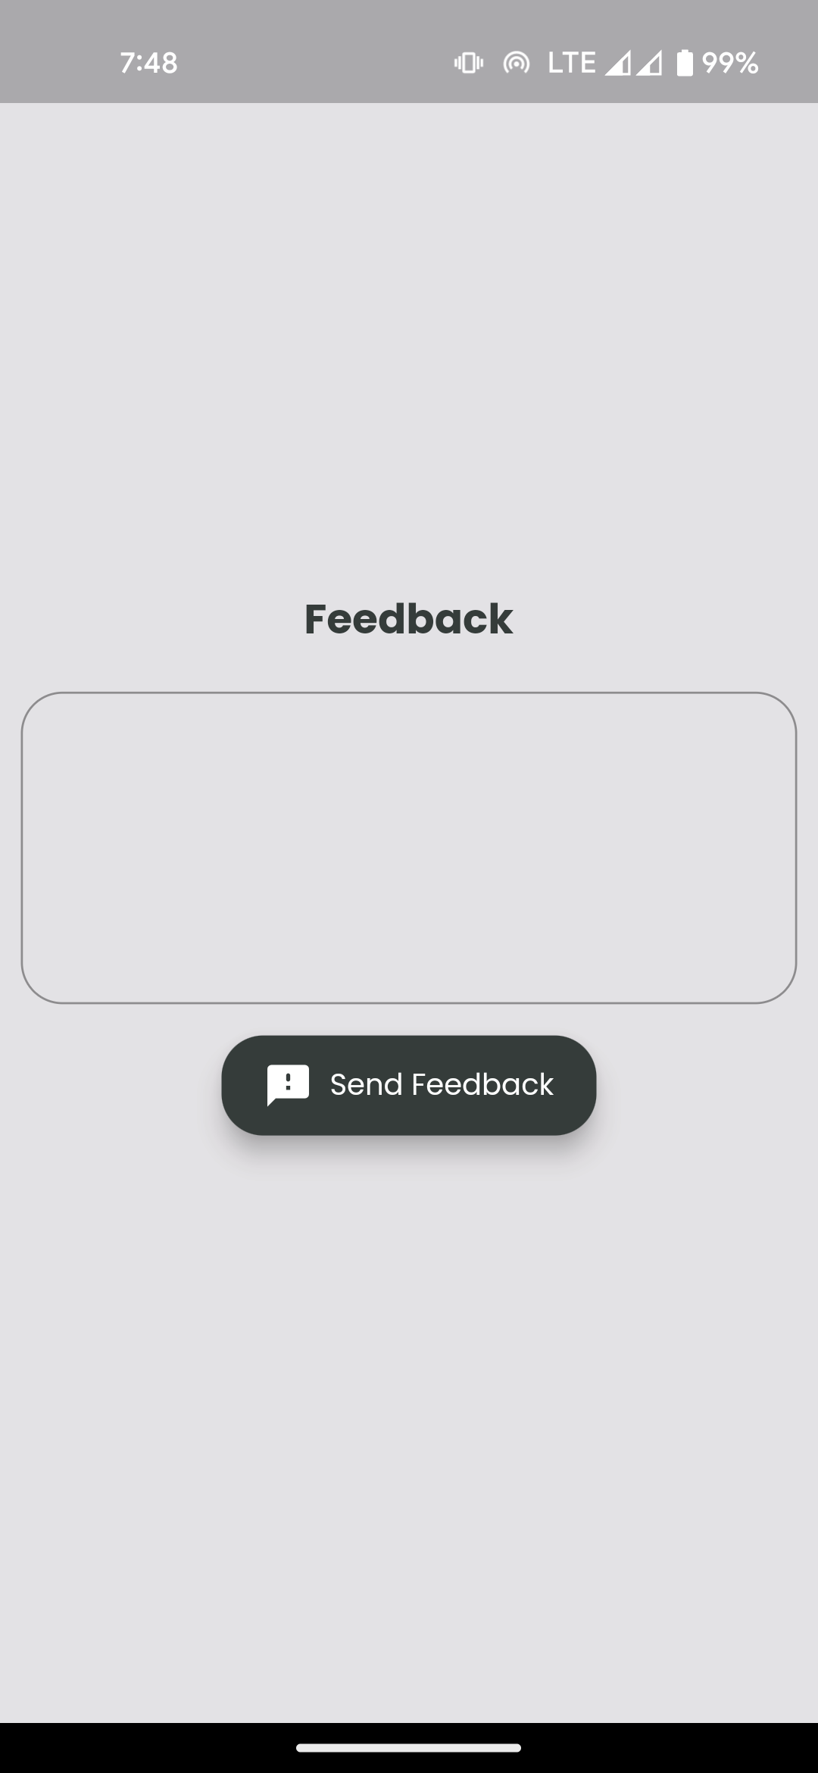
SYSTEM DESIGN
Input Output Screen

Slide 10
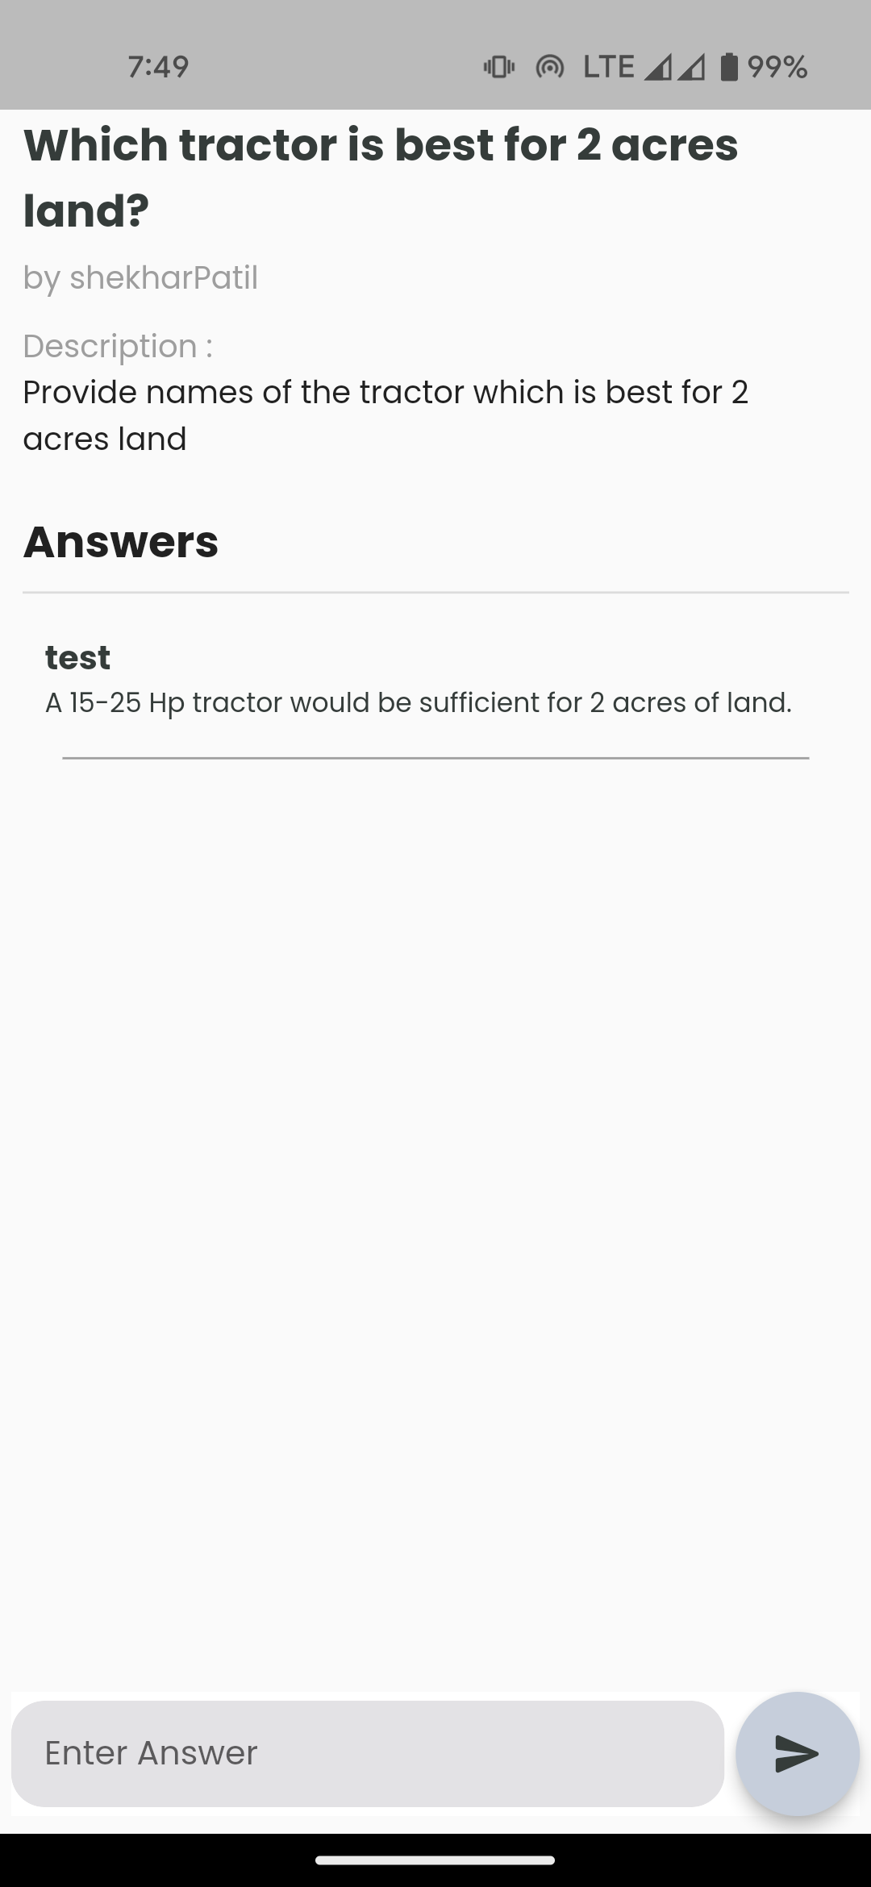
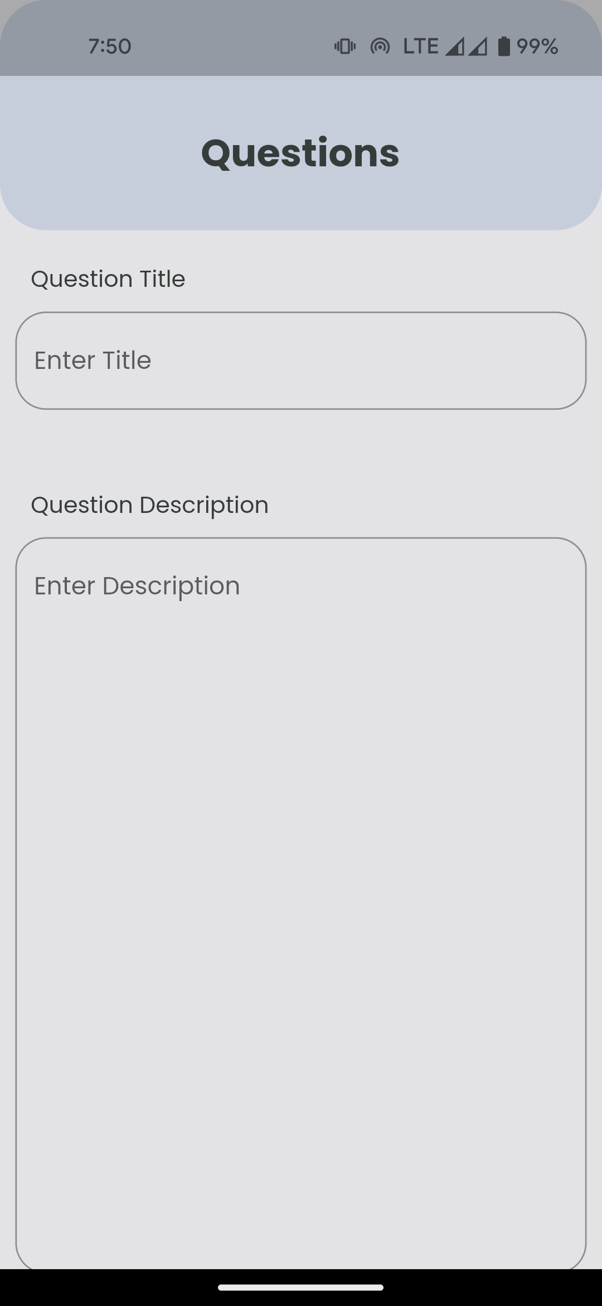
SYSTEM DESIGN
Input Output Screen

Slide 11
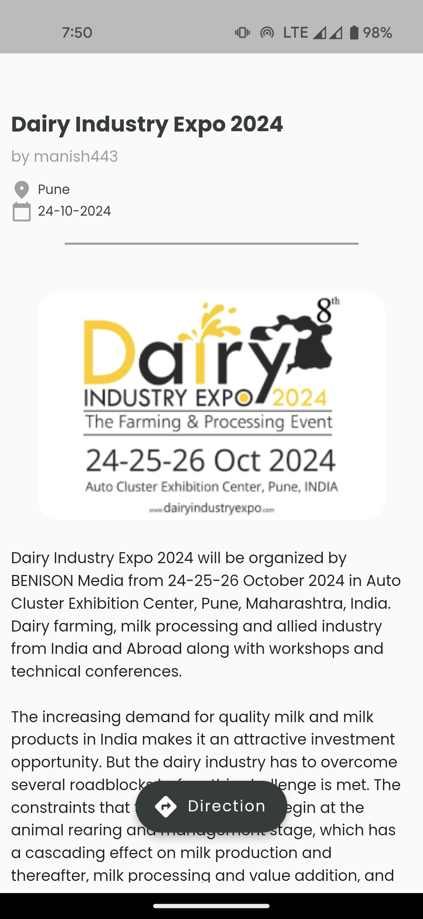
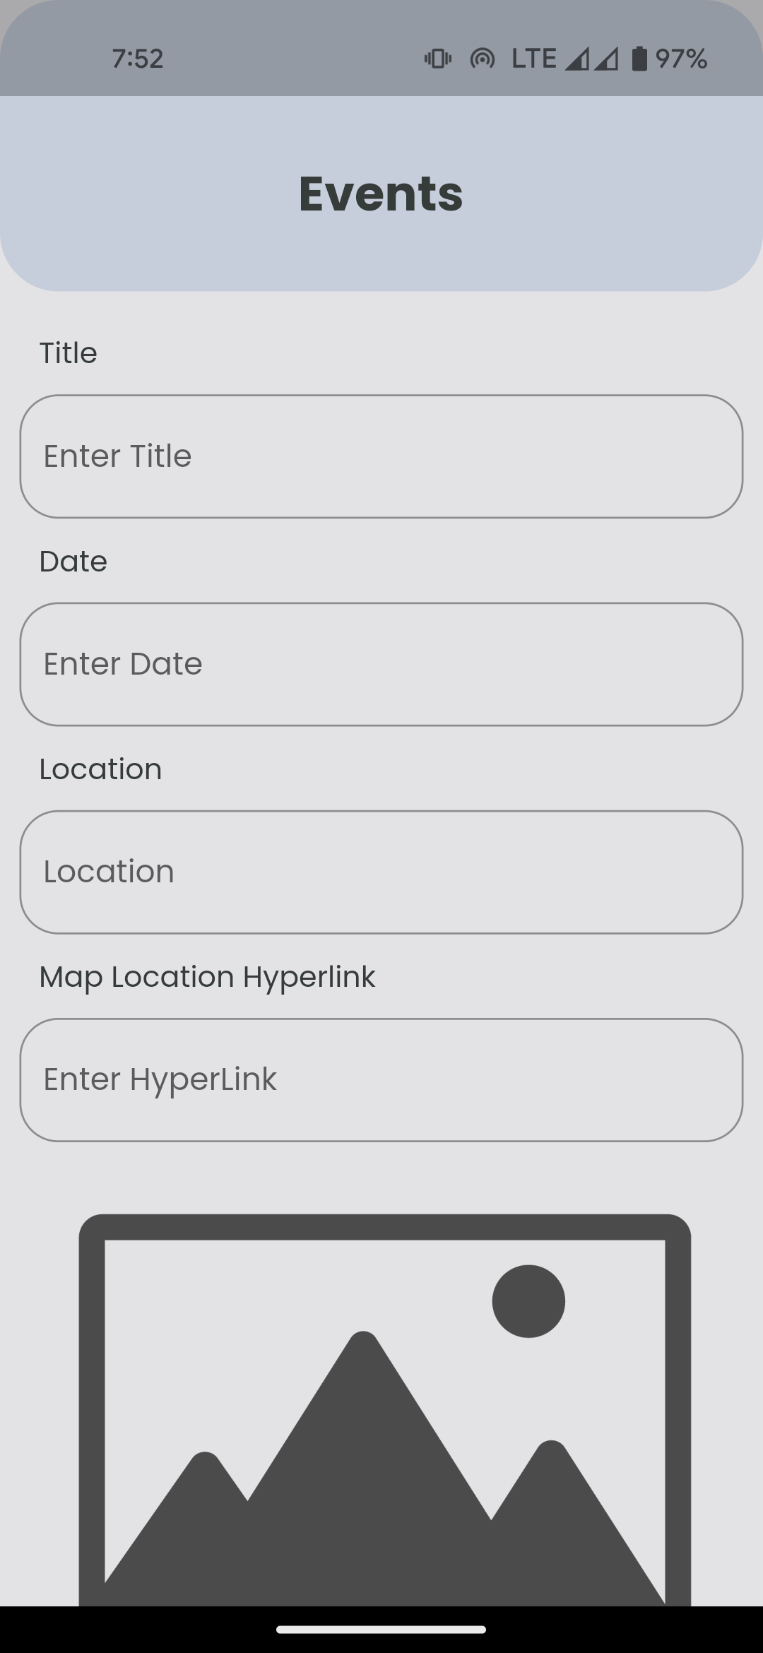
SYSTEM DESIGN
Input Output Screen

Slide 12
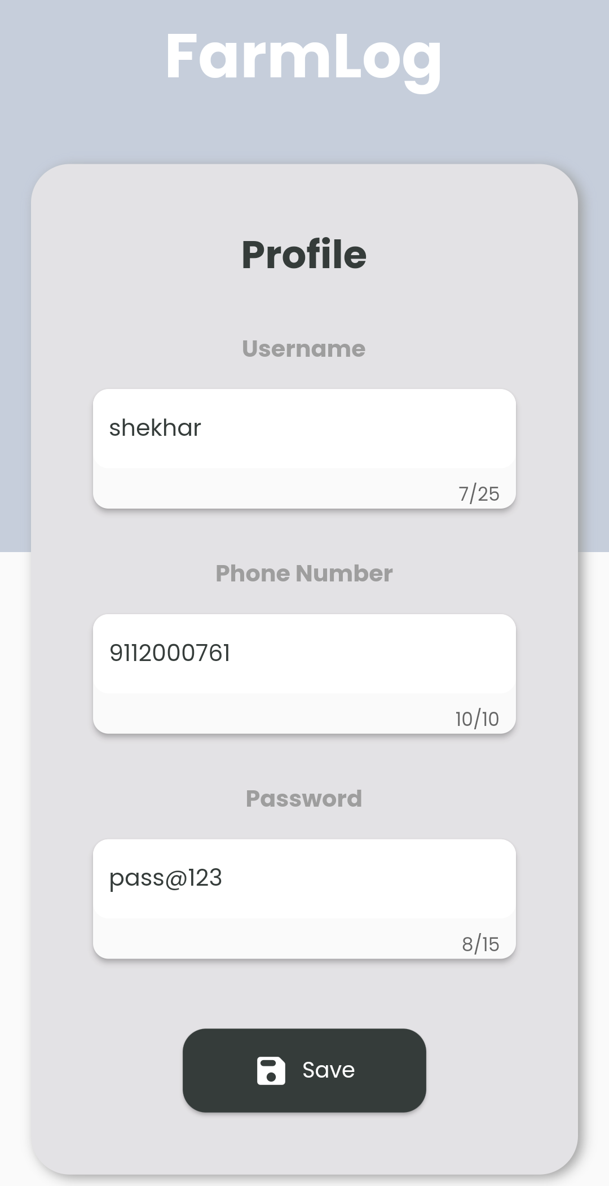
SYSTEM DESIGN
Input Output Screen

Slide 13
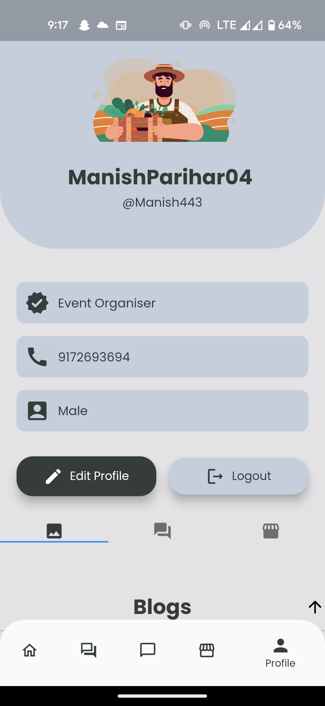
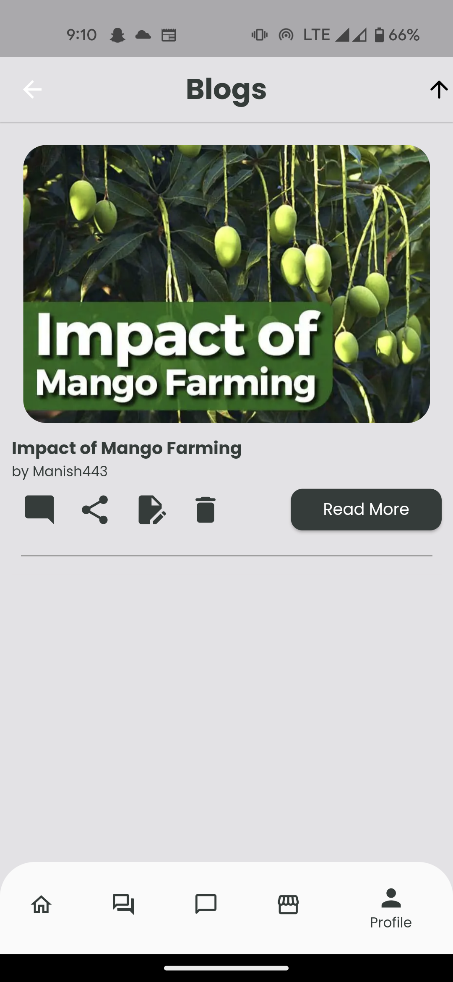
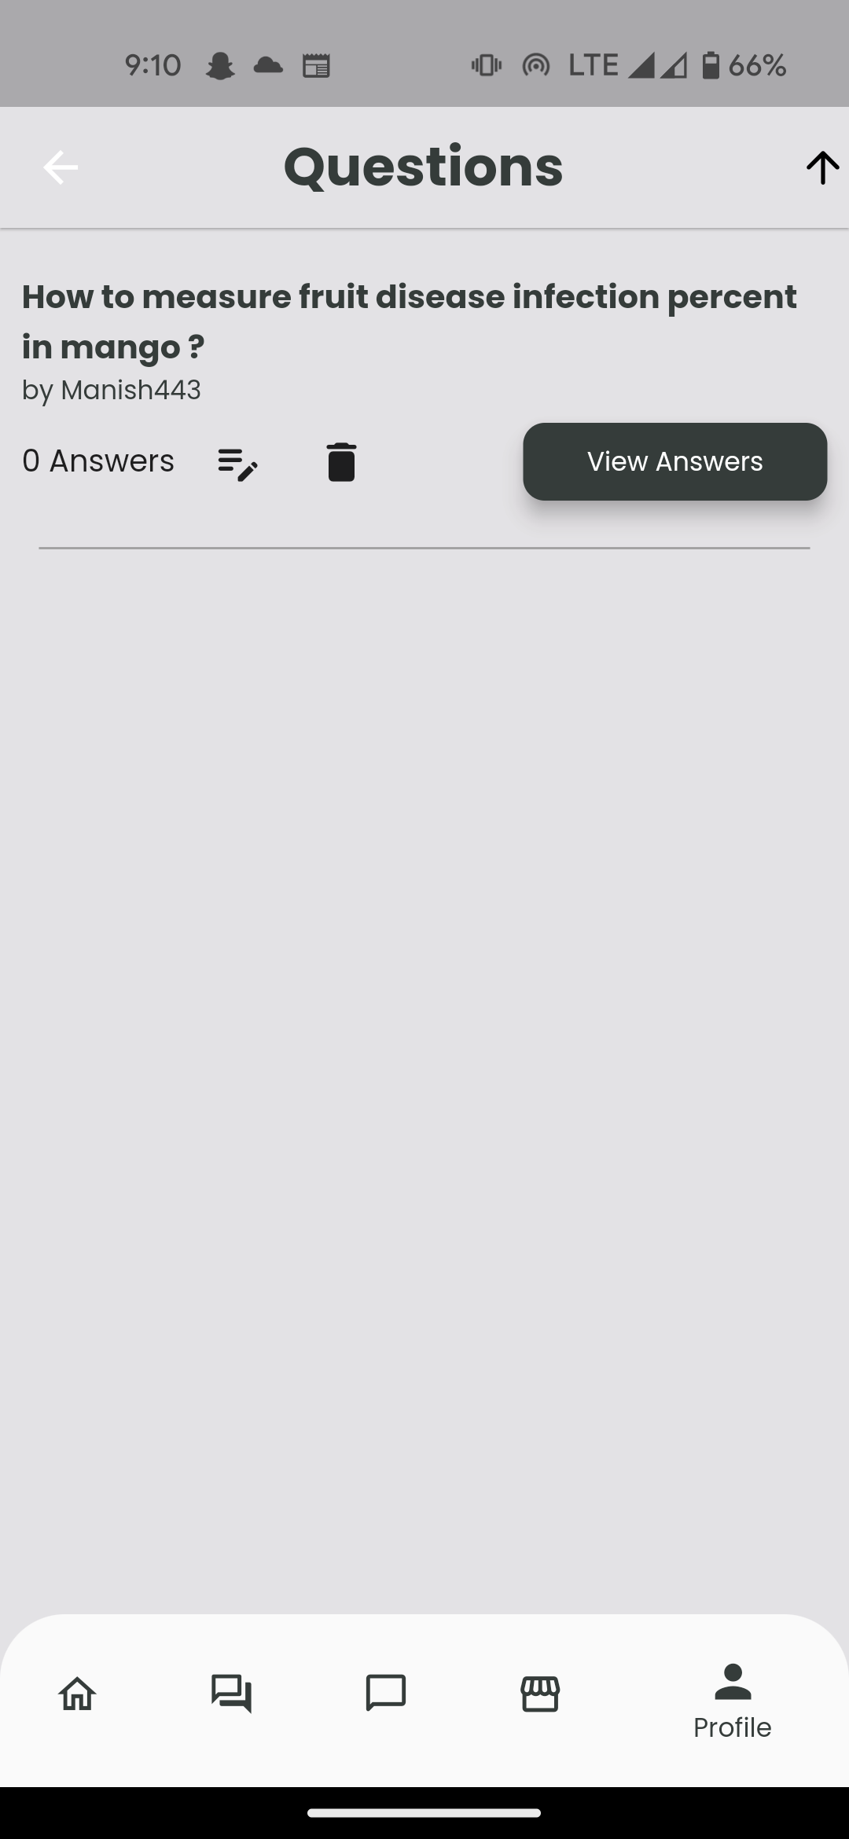
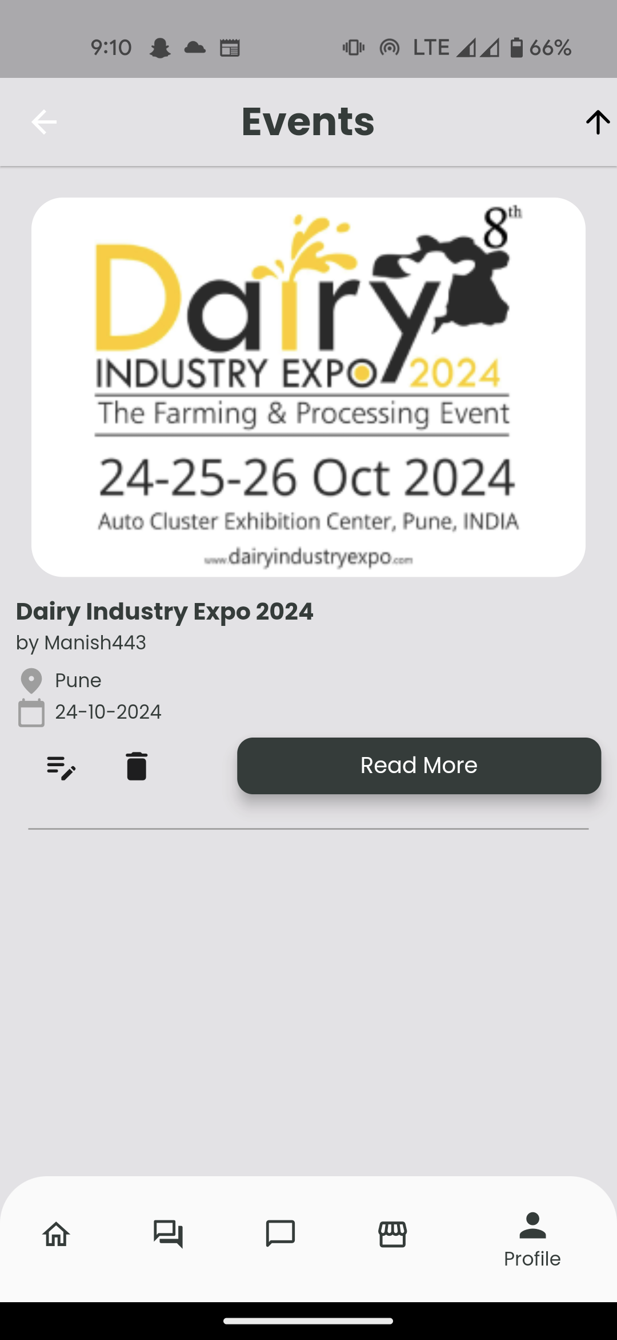
SYSTEM DESIGN
Input Output Screen

Slide 14
SYSTEM DESIGN
Input Output Screen

Slide 15
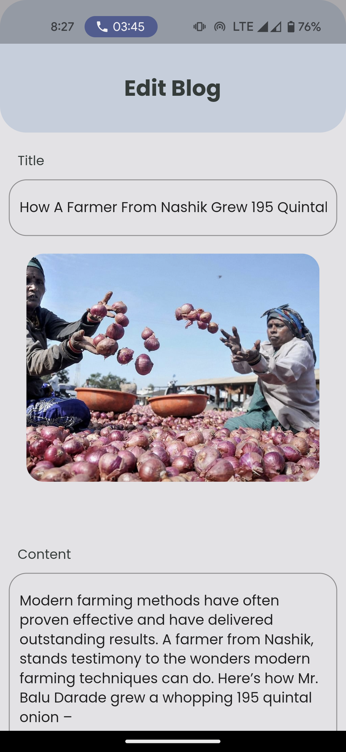
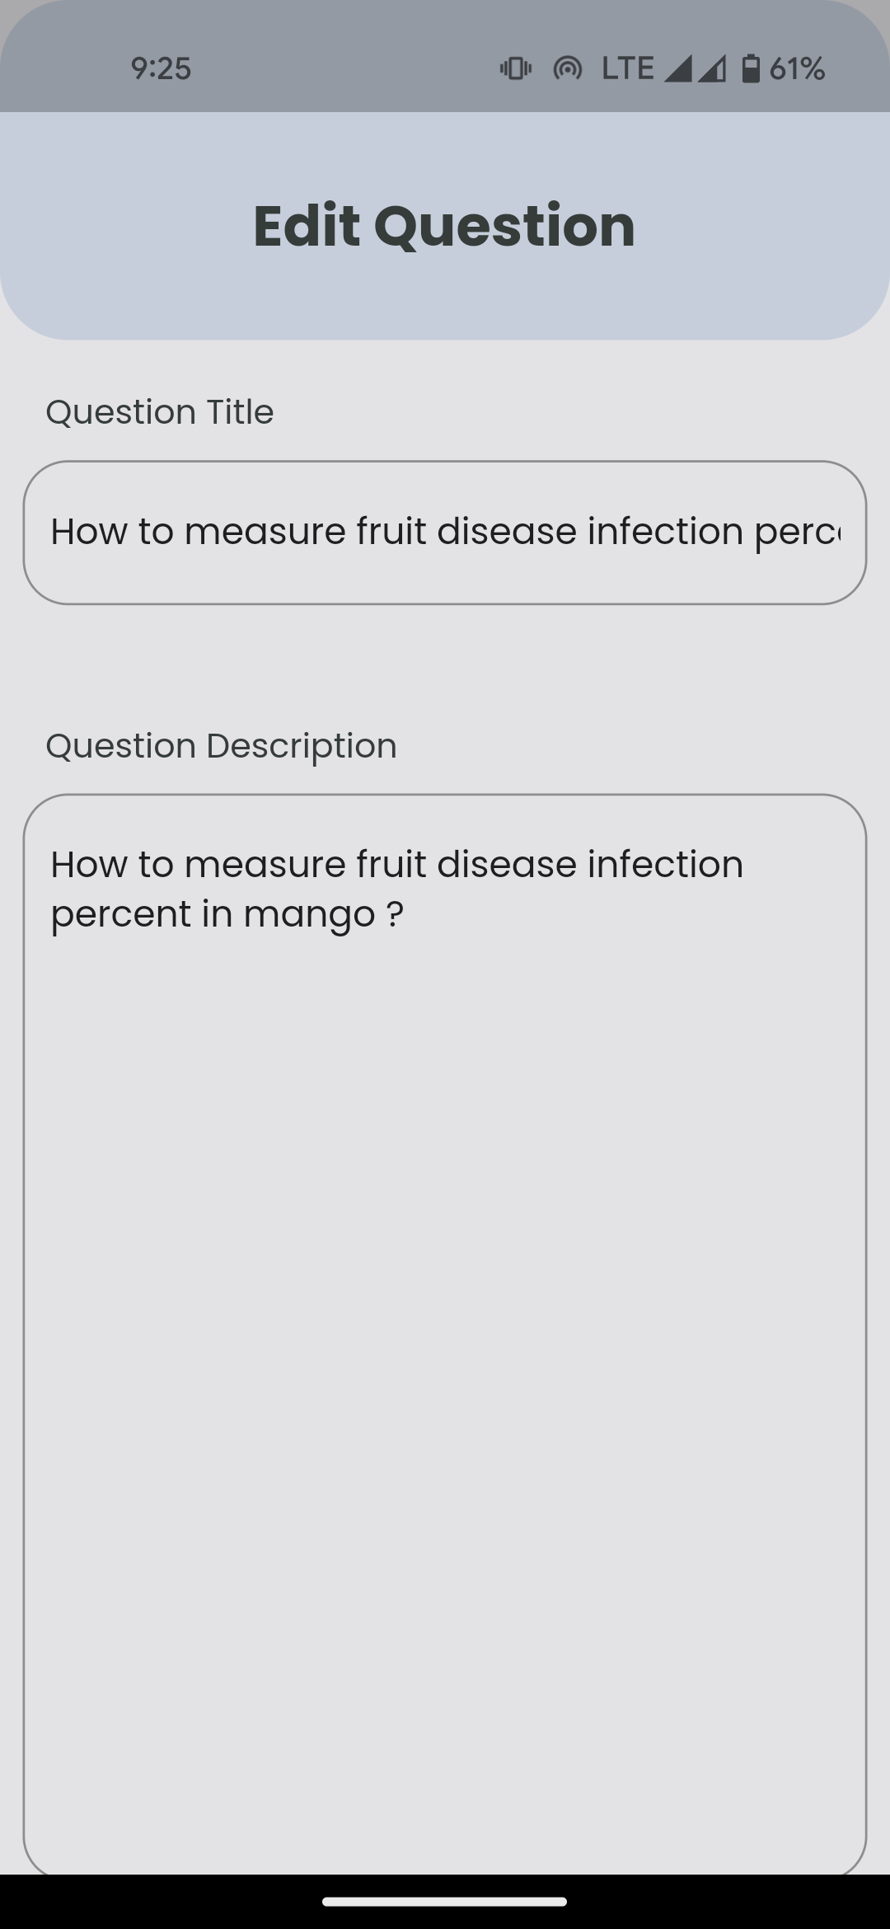
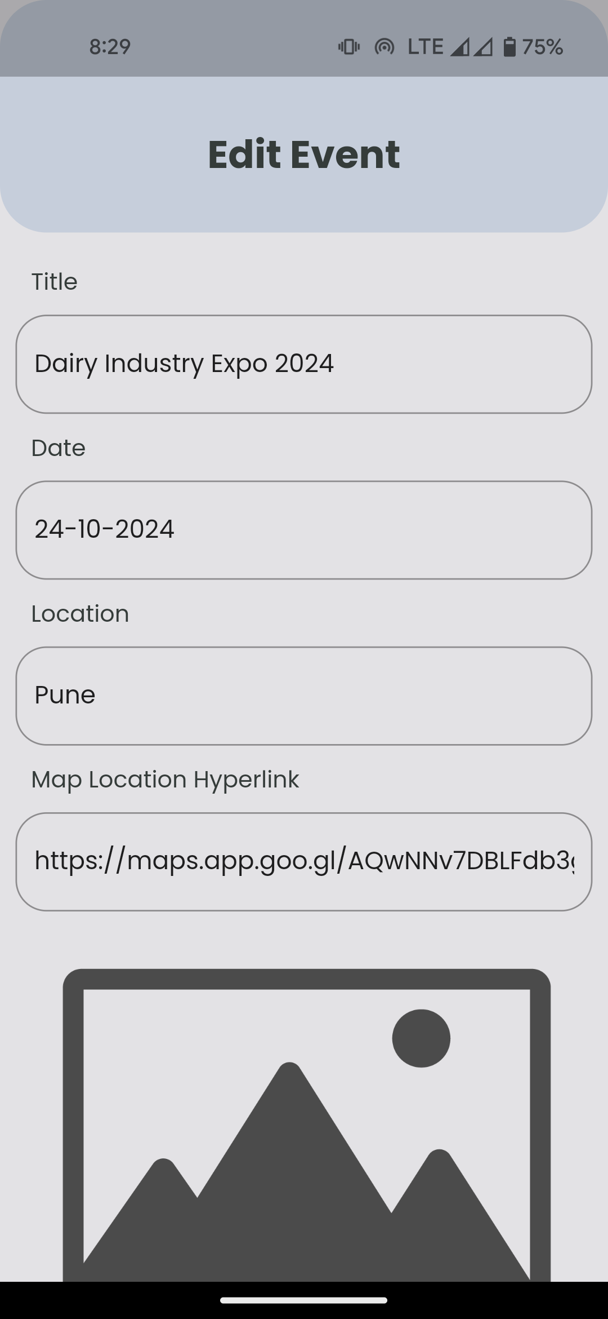
SYSTEM DESIGN
Input Output Screen

Slide 16
LIMITATIONS
Limited Event Categories: The system may only support a limited number of event categories, restricting users from creating or booking events outside of those categories.
Manual Admin Approval: The requirement for manual admin approval for each booking may lead to processing delays, especially during peak times, causing inconvenience to users.
Lack of Event Customization: The system may not allow for much customization of events, limiting the ability of users to tailor events to their specific needs.
Inadequate Capacity Management: The system may not handle capacity limits well, potentially overbooking events or denying bookings when there is still availability.
Limited Payment Options: The system may only support a few payment options, which could limit user participation.
Inadequate Communication Channels: The lack of built-in communication channels between users and admins may lead to confusion or delays in resolving issues related to bookings.

Slide 17
FUTURE SCOPES
1.Reduced entry work: By automating processes and providing user-friendly interfaces, the system has reduced the manual effort required to enter and manage event information.
2.Easy retrieval of information: Users can easily search for and retrieve event information, leading to improved efficiency in accessing relevant data.
3.Reduced errors due to human intervention: Automation and standardized data entry processes have helped minimize errors that can occur with manual data entry, resulting in more accurate information.
4.User-friendly screens to enter the data: The system provides intuitive and user-friendly interfaces for entering event details, making it easier for users to input information accurately.
5.Portable and flexible for further enhancement: The system's architecture allows for easy scalability and future enhancements, ensuring that it can adapt to changing needs and requirements.
7.Web-enabled: Being web-enabled means that the system can be accessed from anywhere with an internet connection, providing flexibility and accessibility to users.
8.Fast finding of information: The system allows for quick and efficient retrieval of information, enabling users to find the event details they need promptly.

Slide 18
Conclusion
The “Event Management System” was successfully designed and is tested for accuracy
and quality. During this project we have accomplished all the objectives and this project
Meets the needs of the organization. The developed will be used in searching, retrieving
And generating information for the concerned requests.
GOALS ACHIVIED
Reduced entry work
Easy retrieval of information
Reduced errors due to human intervention
User friendly screens to enter the data
Portable and flexible for further enhancement
Web enabled.
Fast finding of information request

Slide 19
THANK YOU!!!

